Slide 1

London Housing Price Analysis
Analysis of 32 boroughs from 1995 to 2023

Slide 2
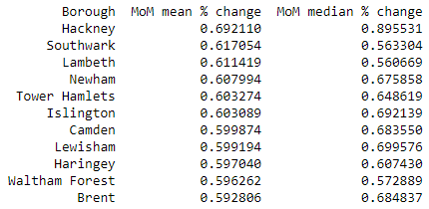
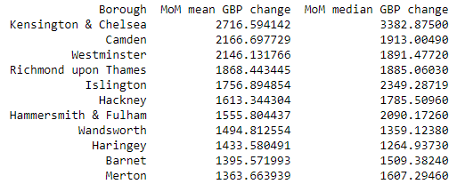
Which boroughs of London have seen the greatest increase in housing prices, on average, over the last two decades?
Monthly change (%)
Monthly change (£)

Slide 3
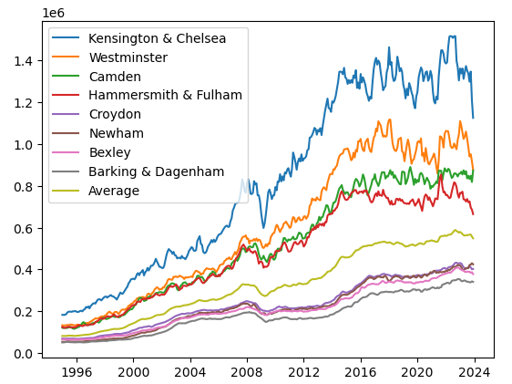
Conclusion – Hackney has the greatest increase in housing prices, on average, over the last two decades
Top 4 and bottom 4 borough’s by average house price
Kensington & Chelsea is most expensive area and therefore has highest gross increase in price.
Percentage increase provides a more appropriate metric due to the wide variance in average house prices by borough

